Slide 2
The weight of duty

Slide 3
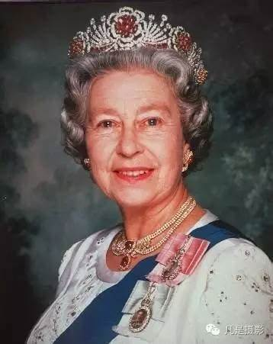
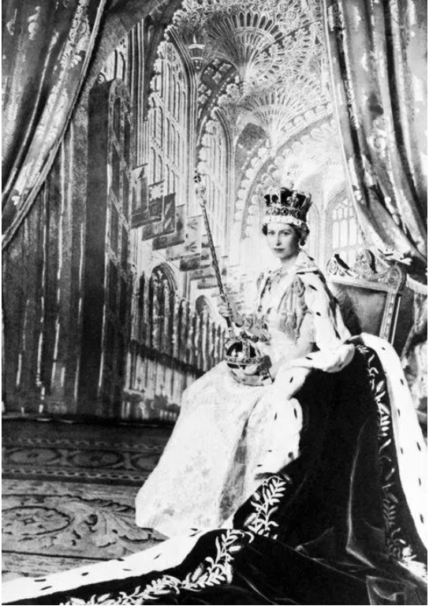
The
weight
欲戴皇冠
2022
责任的重量
1953
of
必承其重
duty
卢君超 胡逢彬

Slide 4
1.summary
2.supplement knowledge
3.feeling
概要
补充知识
感想

Slide 5
summary
In1953,ElizabethⅡ became a queen in British coronation(加冕礼) until 2022.
Her small and somewhat dumpy figure gave people an instinct（本能） to protect.
However,her level stare and wit reflected that this was quite unnecessary.
Of course,she had her own emotion and her own life.Due to her identity she always maintained a detached(超然的)attitude.
As a queen,she did her duty that she swore God to unite the Uk together.

Slide 6

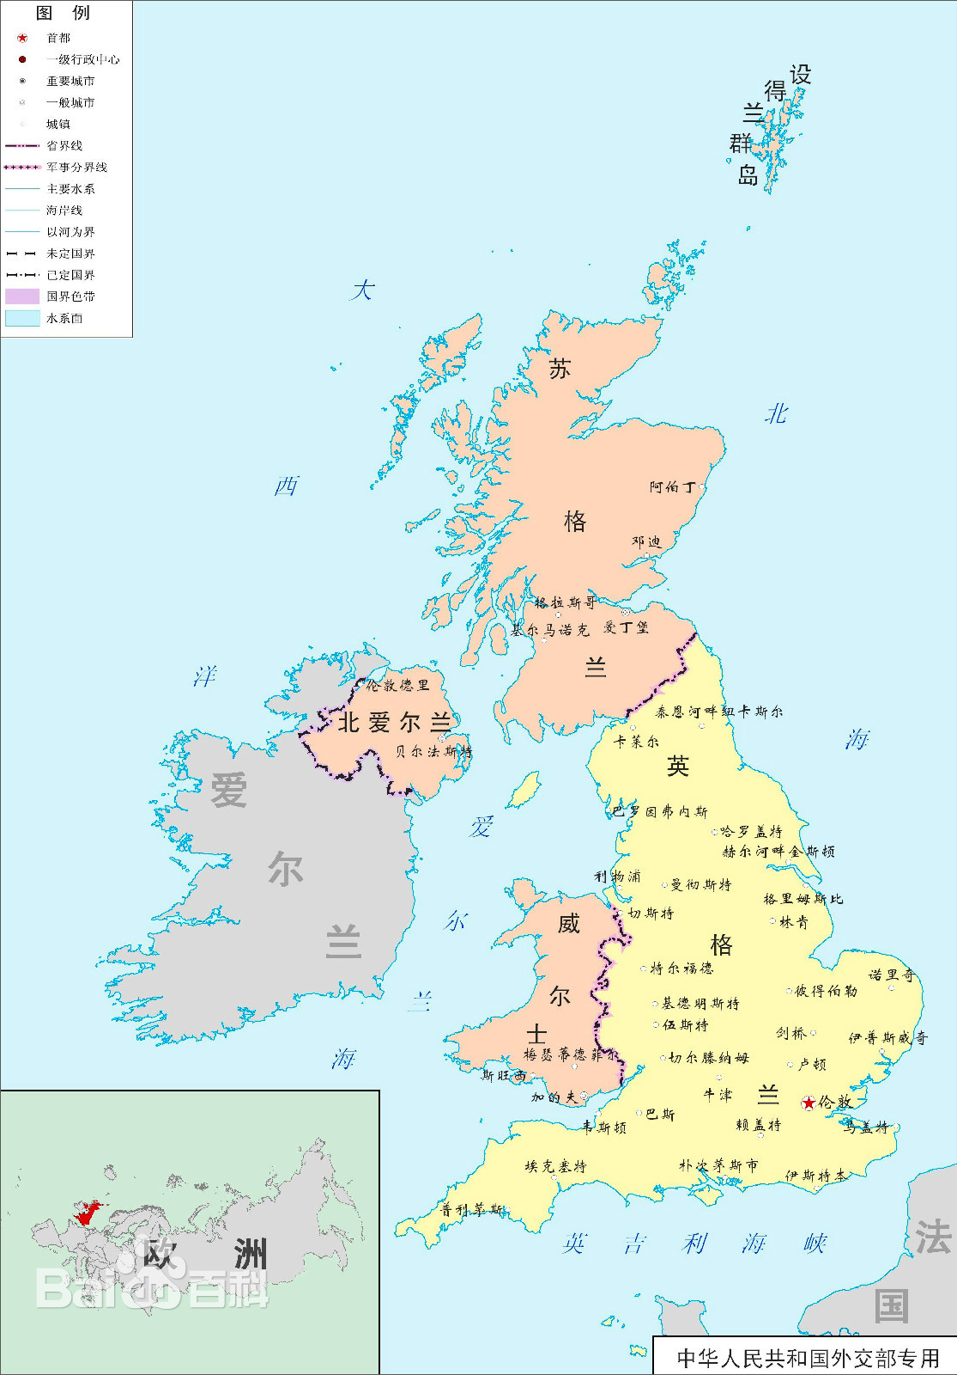
supplement knowledge
Q：Why does the Queen of England have such a significant influence on Britain and even international politics?
A：Culture.
大家都知道，英国王室是没有什么实权，可就是这样一位英国的虚君，为什么依然能对英国甚至国际政治有这么重大的影响力？
答案是两个字：文化。

Slide 7
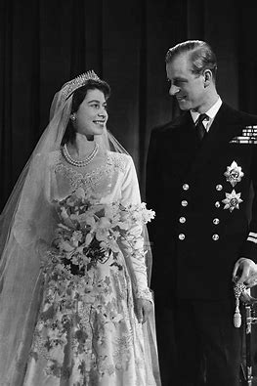
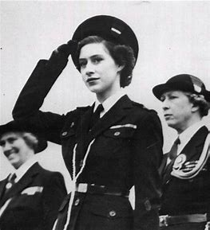
the the
supplement knowledge
英国王室和女王在文化上的影响力，仍是无可替代的。王室和国王不仅是一种历史共同记忆，还是一种道德垂范。它是英国内部各地区，以及与英联邦国家联系的一个共同情感纽带。英国王室之所以搞那么多繁文缛节、甚至略显古板，其实就是要凸出庄重感和历史感，进而向国民乃至英联邦提供精神上的稳定性。

Slide 8
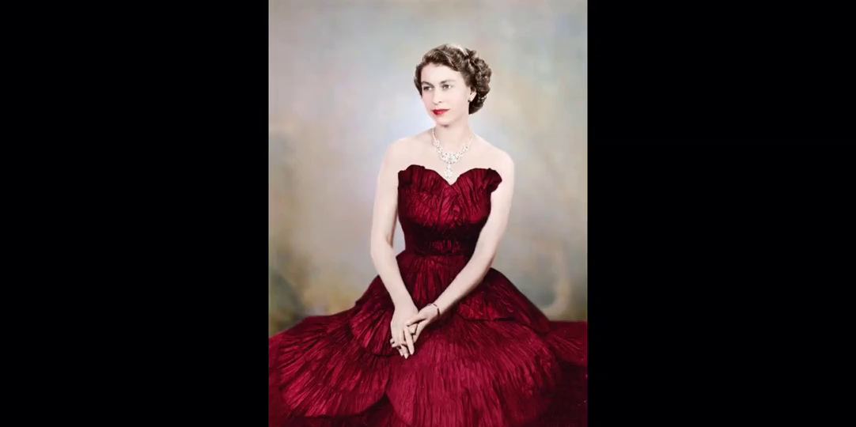

Slide 9
The Weight of Duty
——不是用最短的时间去承诺，而是用最长 的时间去实践
It is extremely important that a country has a good leader. If you want to be a good leader, you have to take responsibility. There is no doubt that the Queen has done well in these sixty years. In fact, for ordinary people, it is not difficult to be responsible, but it is not easy to persist for decades.

Slide 10


In dreams begin the responsibilities
1897到1898这两年叶芝与茉德交往密切，两人友谊升华，茉德告诉了叶芝自己痛苦纠葛的感情生活的事，这是两人认识多年来的第一次深切交流。自此叶芝开始对她之前的种种行为有了同情和理解。1899年叶芝到巴黎找茉德，两人互诉衷情，建立了“灵婚”关系，两人经常交流各自做的梦，叶芝曾有一次在半梦半醒之间发现茉德吻了他。茉德也曾做过和叶芝共结连理的梦。所以叶芝于1914年的诗集取名为《责任》并题词“责任始于梦”。
a thousand readers
have a thousand Hamlets
listen the music
admire this sentence

Slide 11

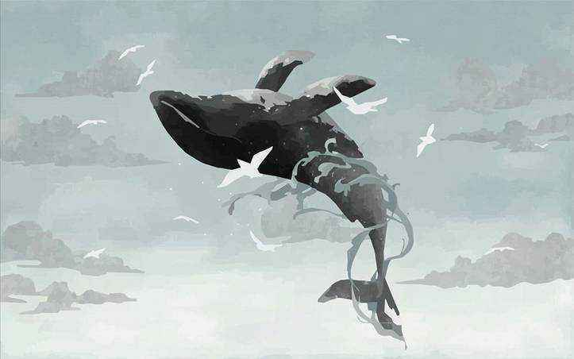

梦是潜意识的表达
而真正的责任铭刻于心
是由心而发
深深相信且坚持
Dreams are expressions of the subconscious（潜意识）
And the real responsibility is engraved in the heart
It comes from the heart
Deeply believe and persist

Slide 12
植入人的潜意识
与梦有异曲同工之妙
故在梦中若存责任
便是真正的责任
Implant the subconscious mind of the person
It's the same as dreams
Therefore, there is responsibility in dreams
It's the real responsibility

Slide 13
That’s all ，thank you.
卢君超 胡逢彬

